Slide 1
PRACTICAL APPLICATION OF AI IN MEDICAL EDUCATION
JAN 22, 2025
11:30 - 1:00 PM

Slide 2
Today's Team
Dr. Brock Mutcheson
Associate Dean, Assessment, Evaluation, and Strategic Analytics
Assistant Professor, Department of Health Systems and Implementation Science
Dr. Kris Rau
Assistant Professor, Basic Science Education
Dr. Farrell Adkins
Assistant Professor, Surgery

Slide 3
INQUIRY TO IMPACT (I2I)
IMPROVING MEDICAL EDUCATION THROUGH INQUIRY AND INNOVATION
The I2I series addresses evolving curricular challenges through collaborative learning and practical skill development.
The goal of I2I is to empower participants to analyze educational issues and implement creative solutions, building valuable teaching resources and establishing VTCSOM as a center of innovation.

Slide 4
Learning Outcomes
Explore AI Tools: Identify and describe the basic functionalities of AI tools currently used in medical education.
Apply AI in Context: Work through real-world scenarios to analyze the potential impact and limitations of AI applications in diverse educational settings.
Using ChatGPT, OpenEvidence, CoPilot
Develop Strategic Approaches: Evaluate and design strategies for integrating AI technologies into educational planning and teaching, addressing practical applications and ethical considerations.

Slide 5
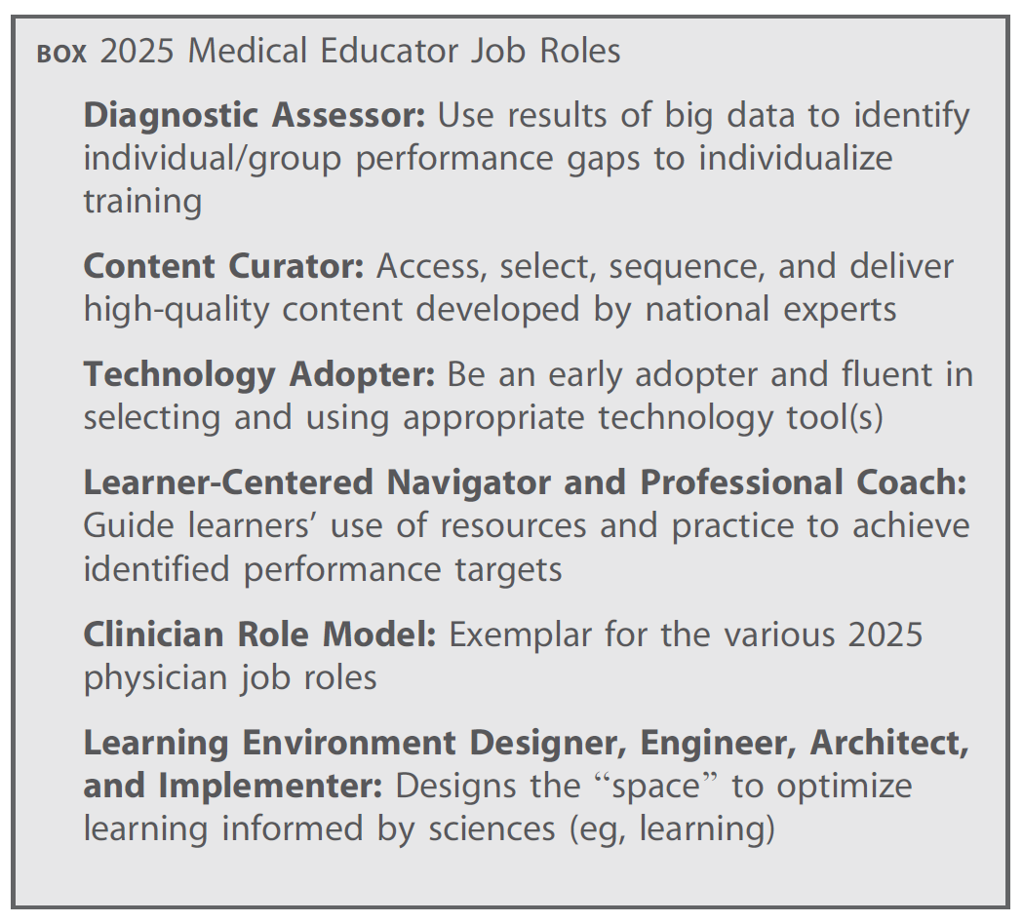
Resource Highlight: Job Roles of the 2025 Medical Educator
Simpson D, Marcdante K, Souza KH, Anderson A, Holmboe E. Job Roles of the 2025 Medical Educator. J Grad Med Educ. 2018;10(3):243-246.

Slide 7
It is estimated that the doubling time of medical knowledge in 1950 was 50 years; in 1980, 7 years; and in 2010, 3.5 years.
In 2020 it was projected to be 0.2 years—just 73 days
The volume of new evidence is overwhelming!

Slide 8
(If time Permits)

Slide 9
AI Allies
RAISE OF HANDS
How many of you are currently using AI tools?
ChatGPT?
Open Evidence?
What percentage of students do you think are using AI tools?
Introduction to the AI in Healthcare Student Group led by Dr. Nick Rider
Notes:
On a scale of 1 (Never) to 5 (Daily),
On a scale of 1 (Uncomfortable) to 5 (Very Comfortable),

Slide 10
Tool 1: ChatGPT

Slide 11
ChatGPT – chatgpt.com

Slide 12
Ways faculty can use ChatGPT for education…
• Develop learning objectives
• Develop STEP-1 style MCQs for exams
• Develop lecture outlines
• Develop clinical case vignettes
• Develop engaging classroom activities

Slide 13
ChatGPT - Scenario
As a busy VTCSOM faculty member, you are always looking for efficient ways to support student learning. Recently, students have asked for more practice problems aligned with each week's Phase 1 content.
Recognizing that creating high-quality questions requires significant time and expertise, you explore ChatGPT.
1
2
3
Use ChatGPT to develop:
A learning objective (choose your topic!)
A STEP-1 style multiple choice question based on learning objective
Rationale for answers
THINK
GROUP
SHARE

Slide 14
ChatGPT-Example
My prompt:
Develop a learning objective for a first-year medical student that focuses on the basic science of neuromuscular disorders. Develop a STEP-1 style multiple choice question based on this learning objective. Provide a detailed rationale for the correct answer and why the distractors are incorrect. Ensure alignment with the learning objective.
Response from ChatGPT:
Describe the pathophysiological mechanisms underlying common neuromuscular disorders, including myasthenia gravis, Lambert-Eaton myasthenic syndrome, and Duchenne muscular dystrophy, and correlate these mechanisms with clinical presentations.
Refinement:
Explain the pathophysiological mechanisms underlying common neuromuscular disorders, including myasthenia gravis, Lambert-Eaton myasthenic syndrome, and Duchenne muscular dystrophy, and demonstrate the ability to correlate these mechanisms with clinical presentations and diagnostic findings.

Slide 15
Tool 2: OpenEvidence

Slide 16
openevidence.com

Slide 18
Scenario
A 70 yo woman presents to the surgical clinic after a recent admission for GI bleeding. She developed anemia to 9.0 which stabilized. A colonoscopy while in-patient revealed a 6cm mass in the sigmoid colon which was biopsy proved to be adenocarcinoma.
How can OpenEvidence improve learning in the clinical environment?
1
2
3
You are a medical student.
What do you ask OE ?
You are a resident.
What do you ask OE ?
You are an educator.
What do you ask OE ?
THINK
Use OpenEvidence:
GROUP
SHARE

Slide 19
Scenario
A 70 yo woman presents to the surgical clinic after a recent admission for GI bleeding. She developed anemia to 9.0 which stabilized. A colonoscopy while inpatient revealed a 6cm mass in the sigmoid colon which was biopsy proved to be adenocarcinoma.
How can OpenEvidence improve learning in the clinical environment?
Student or Resident
Prompt: What are critical signs and symptoms that I would need to inquire about during an HPI on this patient and what are critical physical exam findings?
Prompt: What is an appropriate staging evaluation for this patient?
Educator
Prompt: What questions can I ask to probe the students’ clinical reasoning regarding the staging evaluation of this diagnosis? Specifically include strategies to facilitate higher-order thinking and critical analysis of diagnostic pathways.

Slide 20
Other usage cases
Write a patient handout
Compute a common formula
Suggest or interpret lab results
Write an exam question
Write patient home care instructions
Ask about drug dosing or interactions

Slide 21
Resource Highlights
Don't Forget the HANDOUT from this workshop!
Bowen, J. A., & Watson, C. E. (2024). Teaching with AI: A practical guide to a new era of human learning. Johns Hopkins University Press.
American Medical Association. (n.d.). Application of artificial intelligence in medical education: What is the future of AI? Retrieved January 20, 2025, from https://www.ama-assn.org/practice-management/digital/application-artificial-intelligence-medical-education-what-future-ai
Harvard Medical School Postgraduate Education. (n.d.). 5 ways medical educators can use AI and other technologies. Retrieved January 20, 2025, from https://postgraduateeducation.hms.harvard.edu/trends-medicine/5-ways-medical-educators-can-use-ai-other-technologies

Slide 22
Tool 3: Microsoft CoPilot

Slide 23
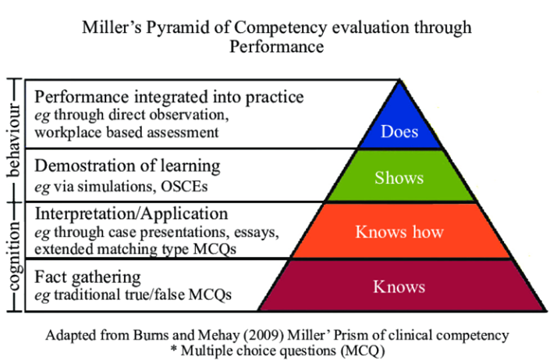
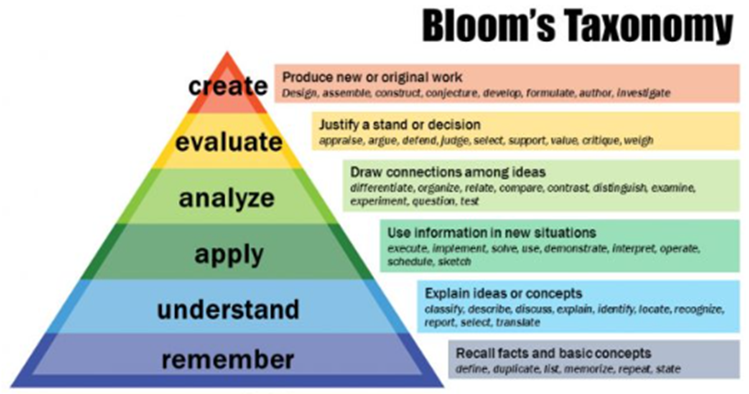
Miller, G. E. (1990). The assessment of clinical skills/competence/performance. Academic Medicine, 65(9 Suppl), S63–S67. doi: 10.1097/00001888-199009000-00045.
Adams NE. Bloom's taxonomy of cognitive learning objectives. J Med Libr Assoc. 2015 Jul;103(3):152-3. doi: 10.3163/1536-5050.103.3.010. PMID: 26213509; PMCID: PMC4511057.

Slide 24
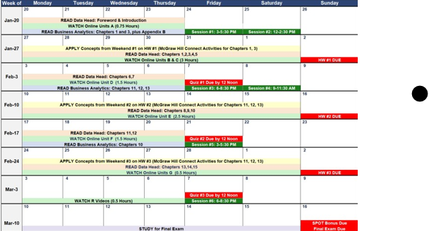
Internal Medicine Clerkship Professionalism Blueprint (Non-Iterative)
Component | Description | Claim | Observable Behaviors | Novice | Advanced Beginner | Competent | Proficient | Expert
Integrity | Adherence to ethical principles and honesty in all actions | The student demonstrates consistent honesty and ethical behavior | • Follows ethical guidelines; • Takes responsibility for errors; • Communicates truthfully | Follows ethical guidelines when guided; Takes responsibility when prompted | Demonstrates basic understanding of ethics; Occasionally takes responsibility | Consistently follows ethical guidelines; Proactively takes responsibility | Demonstrates nuanced understanding of ethics; Encourages peers to uphold ethics | Lives and breathes ethical principles; Role model for integrity
Compassion | Showing empathy and concern for patients | The student consistently shows empathy and concern | • Listens actively to patients; • Provides emotional support; • Addresses patient concerns | Shows basic empathy when interacting with patients | Demonstrates empathy inconsistently; Planned empathy based on patient cues | Proactively shows empathy; Provides emotional support consistently | Anticipates patient needs and addresses them | Demontrates deep consistent empathy in all interactions with patients
Professional Communication | Communication that is respectful clear and effective | The student communicates professionally | • Uses respectful language; • Provides clear instructions; • Actively listens | Basic communication skills; Respectful language when prompted | Communicates effectively in familiar situations; Occasionally clarifies instructions | Consistently uses clear and respectful communication; Adjusts style based on context | Demonstrates sophisticated communication; Adjusts style seamlessly based on context | Uses advanced communication techniques; Writes fot publication/teaching
Teamwork | Collaboration effectively as part of a team | The student works well within a team | • Collaborates in care teams; • Shares information openly; • Supports team decisions | Engages in team discussions when prompted | Demonstrates basic teamwork skills occasionally | Consistently participates in team discussions; Shares information openly | Takes on leadership roles within teams; Supports and improves the team function | Role model for teamwork; Serves as a mentor/leader for peers
Define the parts of your assessment
The construct and its components
The claims we want to make about student professionalism
The observable behaviors (the evidence)
The performance levels and criteria (Dreyfus model)

Slide 25
Internal Medicine Clerkship Professionalism Blueprint (Non-Iterative)
Component | Description | Claim | Observable Behaviors | Novice | Advanced Beginner | Competent | Proficient | Expert
Ethical Practice | Adherence to ethical standards, confidentiality, and accurate documentation. | The student consistently demonstrates adherence to ethical and professional standards. | Maintains confidentiality, avoids falsifying documentation, reports errors promptly. | Follows basic ethical rules but may not understand broader implications. | Recognizes basic ethical principles but struggles with complex situations. | Demonstrates understanding of ethical principles and applies them to routine situations. | Anticipates ethical challenges and addresses them independently. | Handles complex ethical dilemmas intuitively and sets an example for peers.
Interpersonal Skills | Ability to communicate respectfully and empathetically with patients and team members. | The student effectively communicates and collaborates in a respectful and empathetic manner. | Uses clear language, listens actively, and resolves conflicts respectfully. | Communicates minimally or inconsistently; relies heavily on prompts. | Communicates respectfully but lacks consistency and depth in engagement. | Communicates clearly and respectfully in most interactions; collaborates effectively. | Communicates empathetically and adapts style to the audience; resolves conflicts effectively. | Demonstrates exemplary communication and fosters collaboration in teams.
Accountability | Responsibility in managing tasks, punctuality, and responsiveness to feedback. | The student reliably fulfills responsibilities and accepts feedback constructively. | Completes tasks on time, shows up punctually, acknowledges mistakes and seeks to correct them. | Completes tasks only with detailed guidance; struggles with time management. | Manages tasks with some supervision; begins to show accountability. | Reliably completes tasks and seeks feedback; manages time well. | Manages multiple responsibilities autonomously; integrates feedback seamlessly. | Excels in managing responsibilities; models accountability for others.
Professional Development | Commitment to self-improvement and adapting to constructive feedback. | The student actively seeks opportunities for growth and applies feedback to improve. | Seeks feedback proactively, identifies areas for improvement, and applies new knowledge effectively. | Accepts feedback passively but may not implement changes effectively. | Shows willingness to improve but needs guidance to identify specific goals. | Identifies areas for growth and implements feedback with moderate supervision. | Proactively seeks advanced learning opportunities and integrates feedback consistently. | Serves as a role model for continuous improvement and professional growth.

Slide 26
Group
Reflection & Discussion

Slide 27
Reflection & Discussion
Evaluate the quality of the prompts you used. How can they be improved?
In what ways could AI tools contribute to the development of your teaching skills? Discuss potential impact and limitations to AI in your role as an educator.
What types of tasks or challenges would you like AI tools to help you with in your role as a medical educator?

Slide 28
Reflection & Discussion
How can we ensure that AI remains a complement to educators?
What are the first steps you would take to integrate AI into your teaching or curriculum?
What do you think students expect from educators in terms of using AI in their training?

Slide 29
Learning Outcomes
Explore AI Tools: Identify and describe the basic functionalities of AI tools currently used in medical education.
Apply AI in Context: Work through real-world scenarios to analyze the potential impact and challenges of AI applications in diverse educational settings.
Using ChatGPT, OpenEvidence, CoPilot
Develop Strategic Approaches: Evaluate and design strategies for integrating AI technologies into educational planning and teaching, addressing practical applications and ethical considerations.

