Slide 1
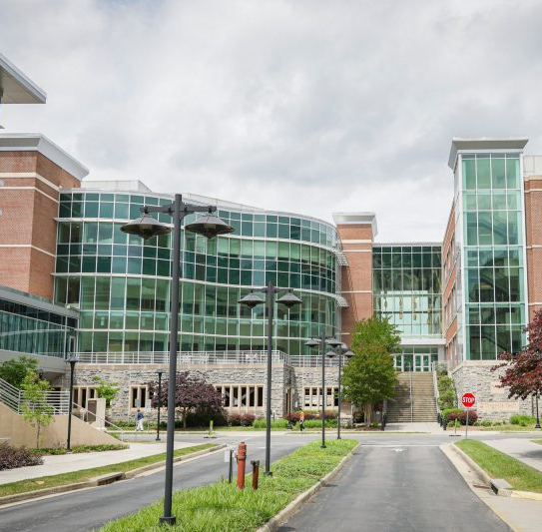
AI in Action: Applications of AI in VTC Medical Education
February 19, 2025
AI in Healthcare Club and Office of Educational Affairs

Slide 2
INQUIRY TO IMPACT (I2I)
IMPROVING MEDICAL EDUCATION THROUGH INQUIRY AND INNOVATION
The I2I series addresses evolving curricular challenges through collaborative learning and practical skill development.
The goal of I2I is to empower participants to analyze educational issues and implement creative solutions, building valuable teaching resources and establishing VTCSOM as a center of innovation.

Slide 3
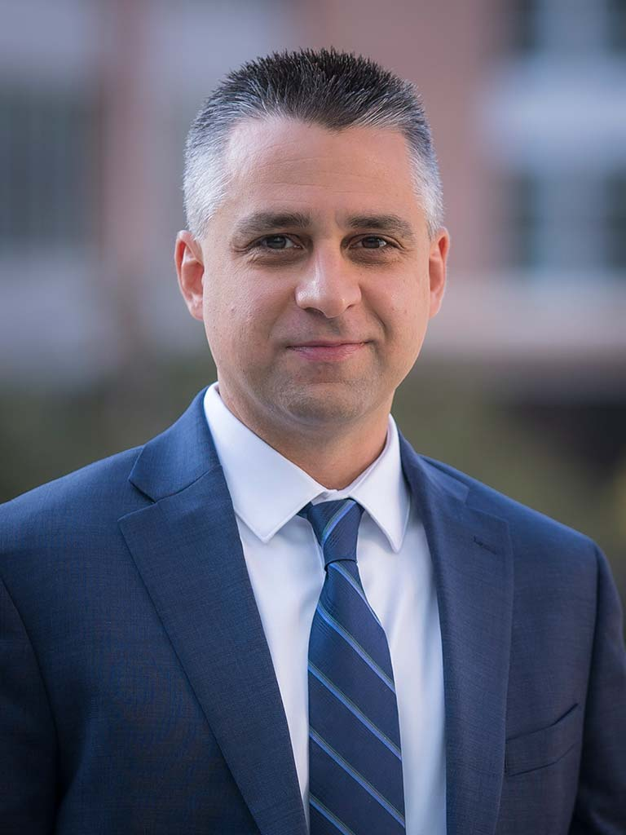
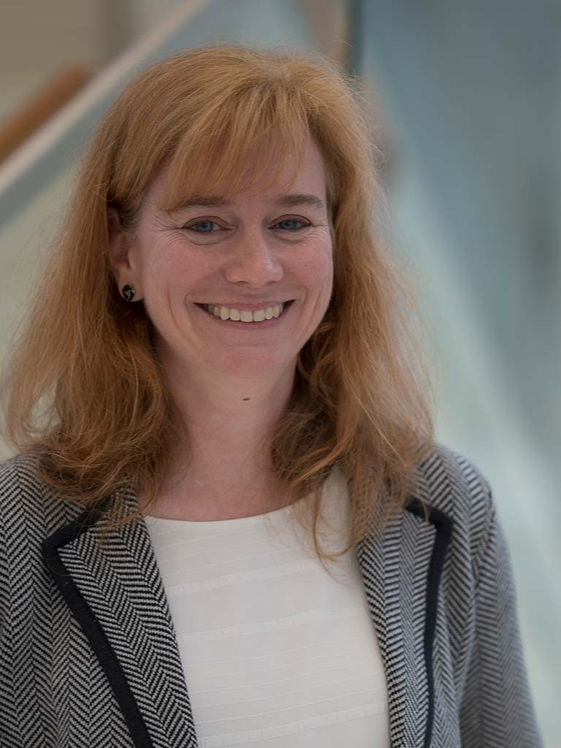
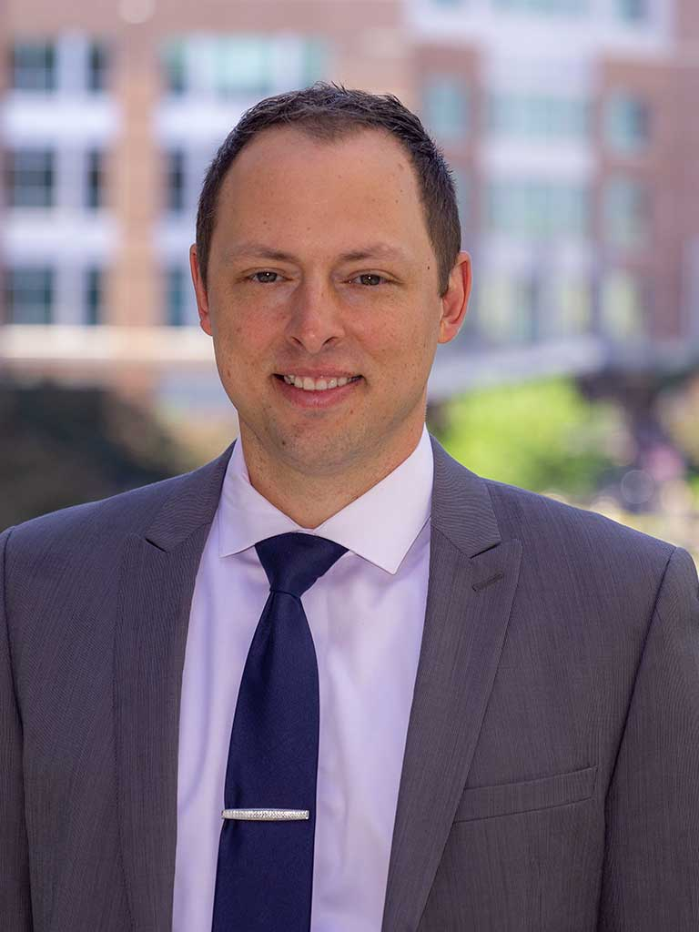
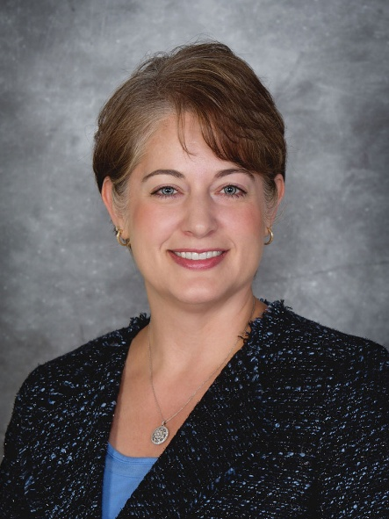
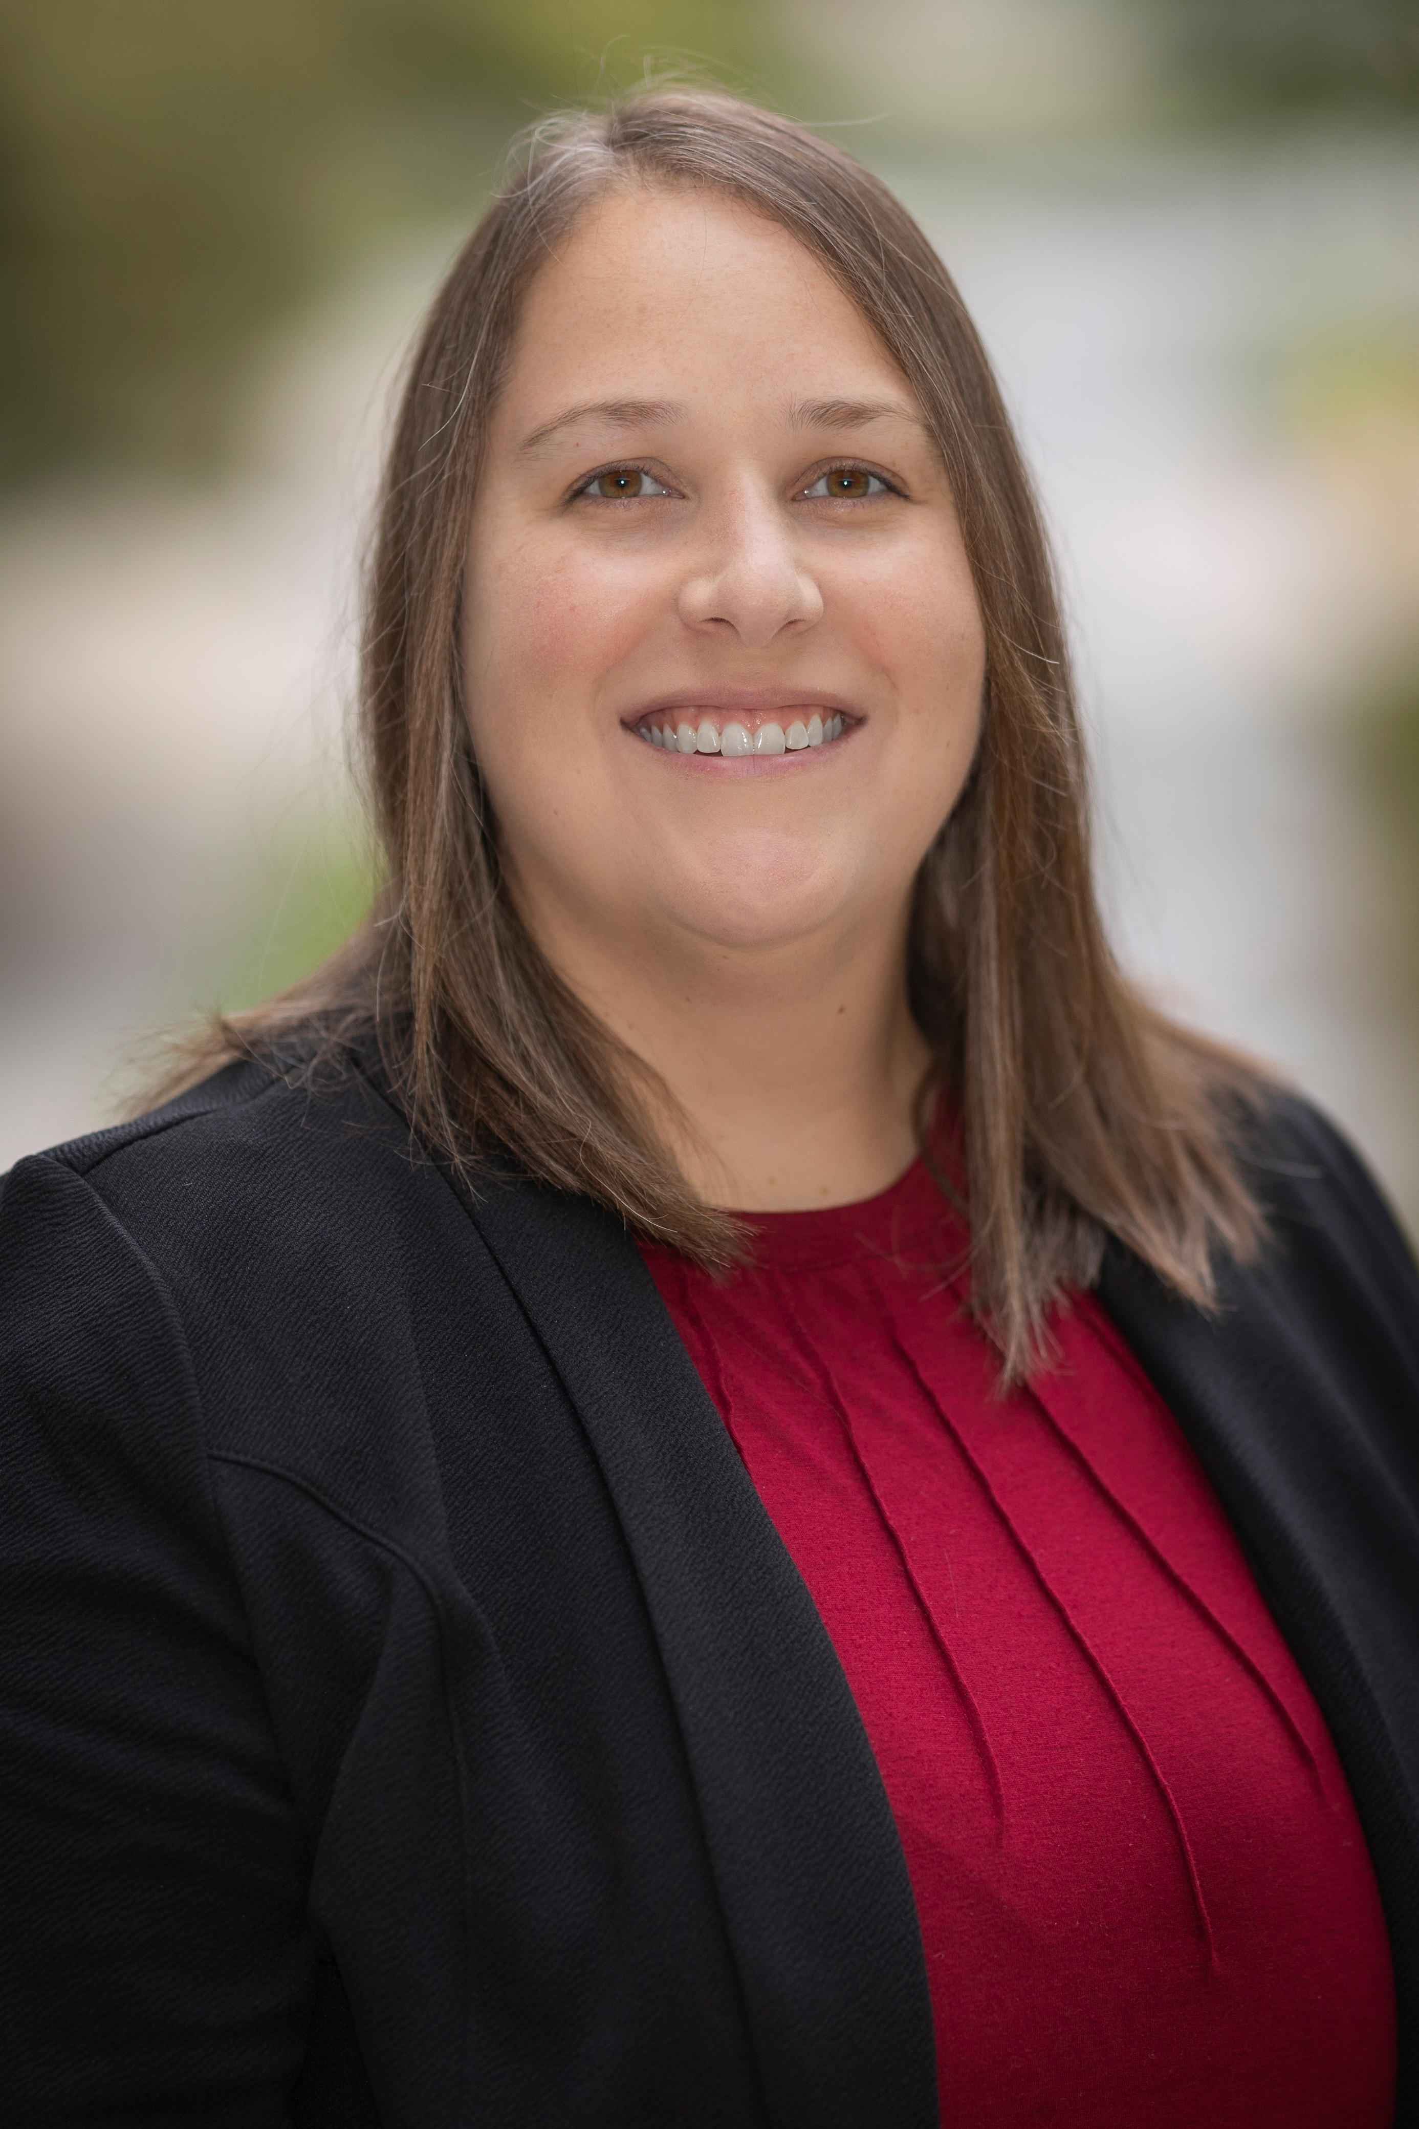
Collaboration Team
Jed Gonzalo, MD MSc
Professor of Medicine and Health Systems and Implementation Science
Senior Associate Dean for Medical Education
Leslie LaConte, PhD
Associate Dean, Research
Director Foundational Science Curriculum
Brock Mutcheson, PhD, MEd
Assistant Dean, Assessment and Program Evaluation
Lee Rakes, PhD
Senior Director of Educational Affairs
Jennifer Cleveland, PharmD, BCPS, MBA
Director, Problem-Based Learning
Assistant Professor, Basic Science Education
Alaina Guerry
Manager, Educational Affairs

Slide 4
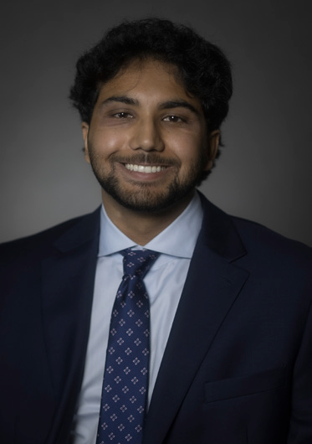
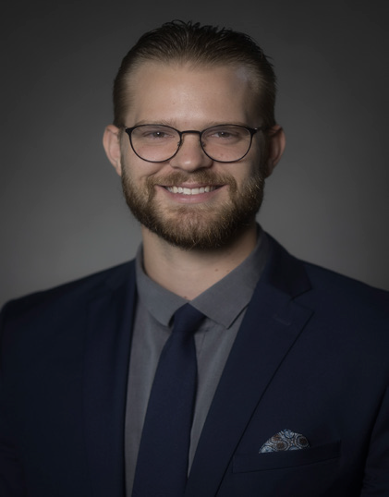
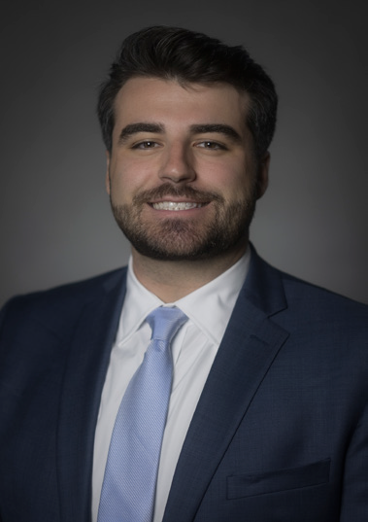
Artificial Intelligence in Healthcare Club
Saif Pasha
Founder & President
Calvin Harris
Co-President
Cole Pieroni
Vice President

Slide 5
Introduction & Learning Outcomes
Interactive, case-based demonstration of the utility of AI in medical education
Discussion on current and future use-cases of AI for students and faculty.
Objectives:
1. Explore ways faculty can integrate AI into workflow.
2. Identify ways that students are utilizing AI.
3. Discuss how AI can be optimally integrated into VTCSOM curriculum.

Slide 6
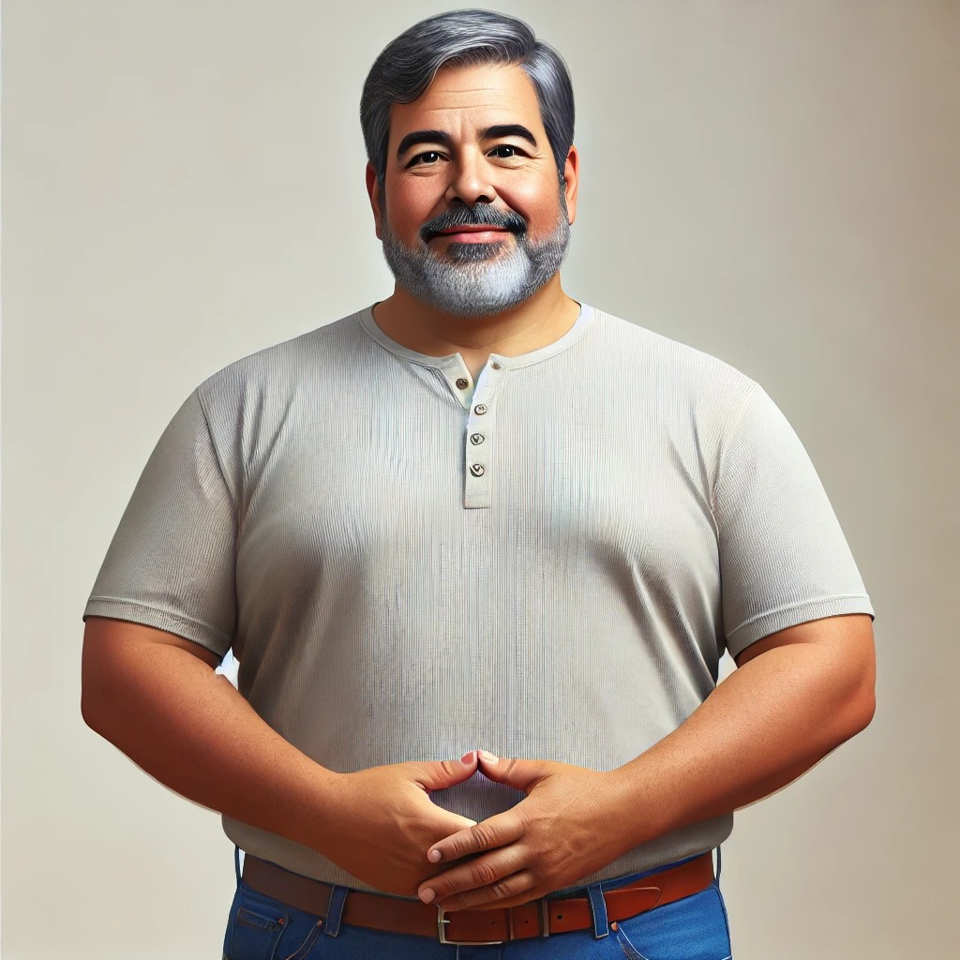
Chief Complaint
Mr. Dylan Herrera is a 61-year-old man who presents to the emergency department with the chief complaint of nausea and bloating.

Slide 7
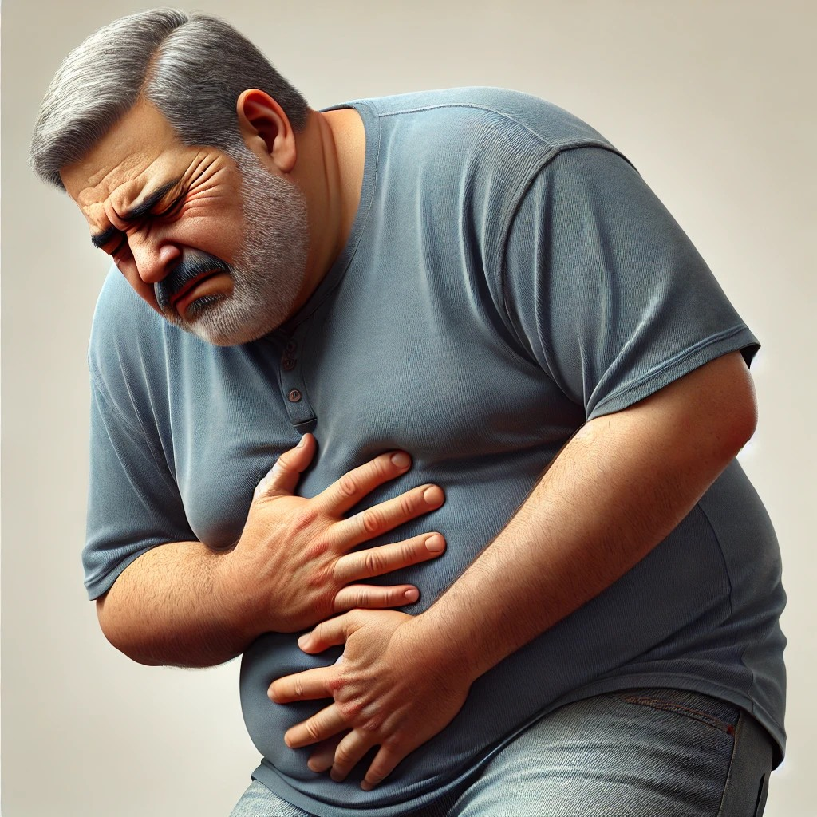
History of Present Illness
Began feeling ill two weeks ago during a trip to Guatemala
Initial symptoms were muscle aches, fatigue, and epigastric pain
Tested positive for COVID-19 and followed quarantine guidelines
Describes pain as crampy with a sensation of fullness
Motrin, Pepcid, Protonix, and Pepto Bismol provided no improvement
Reports loss of appetite and minimal food intake over past two weeks
Presented to the emergency department today due to onset of vomiting this morning
Persistent abdominal pain and bloating progressively worsening

Slide 8
Differential Diagnosis
Chief Complaint: Mr. Dylan Herrera is a 61-year-old man who presents to the emergency department with the chief complaint of nausea and bloating.​
HPI:
Began feeling ill two weeks ago during a trip to Guatemala
Initial symptoms were muscle aches, fatigue, epigastric pain
Tested positive for COVID-19 and followed quarantine guidelines
Persistent abdominal pain and bloating progressively worsening
Describes pain as crampy with a sensation of fullness
Motrin, Pepcid, Protonix, and Pepto Bismol provided no improvement
Reports loss of appetite and minimal food intake over past two weeks
Presented to the emergency department today due to onset of vomiting this morning
As a group, generate your own list of differential diagnoses. (2 min)
Use ChatGPT to generate a differential diagnoses list. (2 min)
Come together to discuss.

Slide 9
PMH, Medications, & FHx
Medications:
Cyclosporine (75mg, PO/QD)
Ibuprofen (400mg, PRN)
Allopurinol (300mg, PO/QD)
Famotidine (10 mg, PO/BID)
Pantoprazole (20 mg, PO/QD)
Bismuth subsalicylate (262 mg, PRN)
Chronic Conditions:​
Interstitial cystitis​
Gout
Immunizations and Screening:​
Up to date​
Family History:​
Mother: Dementia, Lung Cancer​
Father: Dementia​
Sister: Type II Diabetes​

Slide 10
Social History
Lifestyle
Background
Lifestyle:
Diet: Diet consists of mostly fast food with limited vegetables.
Caffeine: Drinks coffee 2-4 cups / day.
Exercise: Walks regularly.
Sleep: Sleeps 6 - 8 hours nightly.
Hobbies: Reading and watching TV.
Habits:
Tobacco: Does not report any tobacco use.
ETOH: CAGE (-/-/-/-), reports occasional alcohol use.
Recreational drugs: Does not report any illicit drug use.
Background:
Employment: Customer service representative for Appalachian Power.
Military service: None.
Education: Bachelor's degree.
Relationships & Support Systems:
Living situation: Lives with his wife.
Sexual hx: Sexually active with his partner. Intermittent condom use.
Barriers to care: He is enrolled in Medicaid and has significant financial barriers to care. Spanish is primary language but is fluent in English.
Relationships & Support Systems
Habits

Slide 11
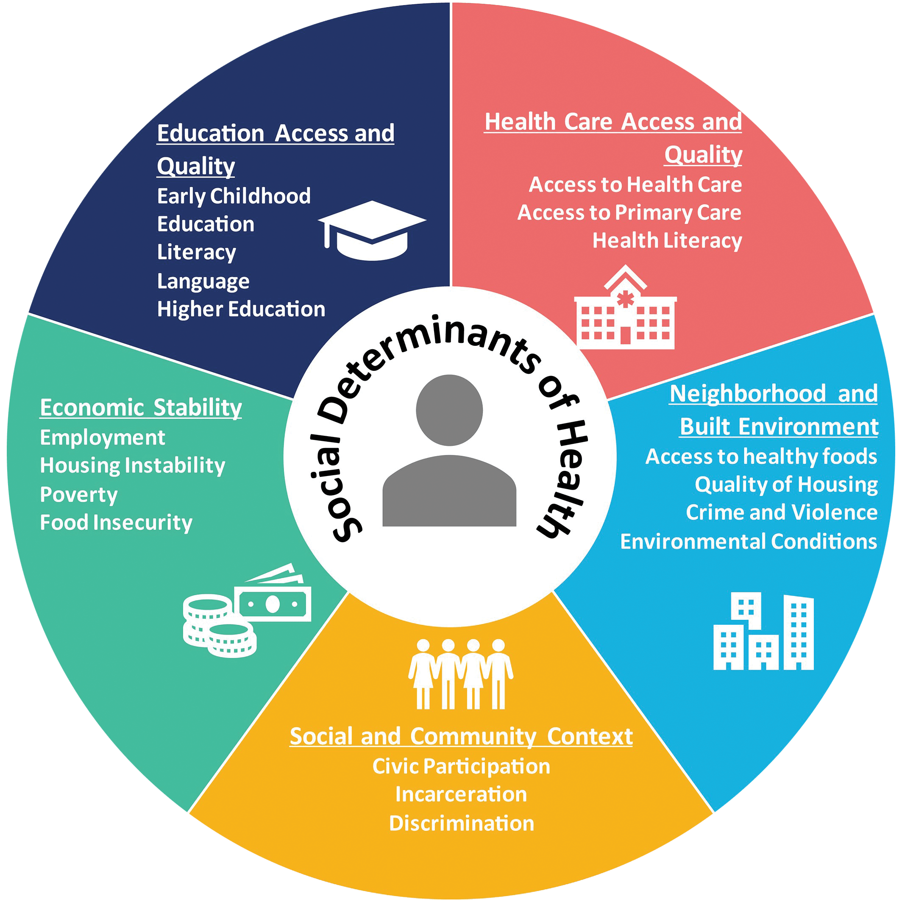
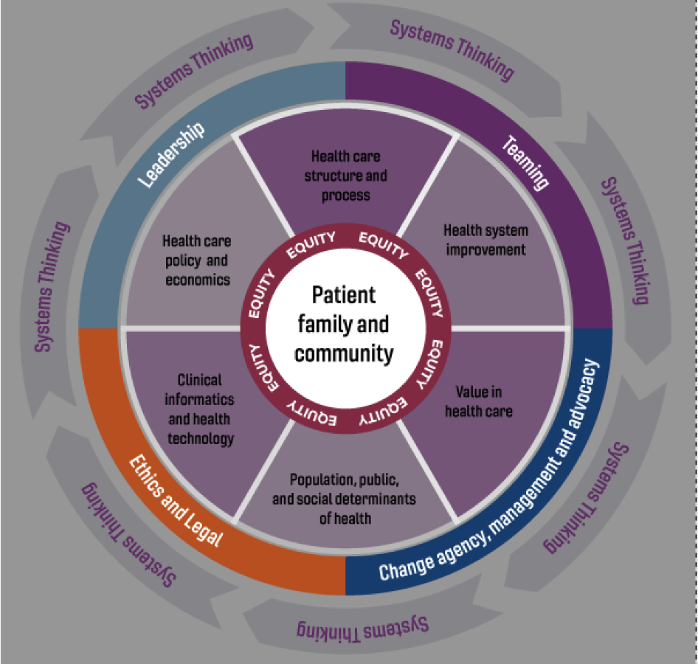
Social Determinants of Health
3. Come together to discuss what you found.
1. Use ChatGPT to explore how this patient's social determinants of health may affect his past and current care. (2 min)
2. Investigate ChatGPT's ability to provide information on services that would be covered by Medicaid in Virginia. (2 min)

Slide 12
ROS & Physical Exam
General: No fever, night sweats, or chills. Endorses weight loss with loss of appetite.
HEENOT: No vision changes. No sore throat.
Respiratory: No cough, shortness of breath, or wheezing.
Cardiovascular: No chest pain, palpitations.
Gastrointestinal: Endorses nausea, vomiting, and bloating. Denies constipation, diarrhea, melena, or hematochezia.
Genitourinary: No dysuria or hematuria.
Musculoskeletal: No joint stiffness, tenderness, or swelling.
Respiratory rate | 20/min
Pulse | 102/min
Blood Pressure | 154/88
Temperature (oral) | 97.9° F (T_{max} 102)
Weight | 81.6kg
Height | 173cm
SpO₂ | 98%

Slide 13
Lab Results
CBC:
CMP:
Additional Labs:
Parameter | Result
WBC | 13,900 (H)
RBC | 4.48
Hgb | 14.7
Hct | 41.9
MCV | 93.5
MCH | 32.8
MCHC | 35.1
Plt | 289,000
Neutrophils | 75.3 (H)
Lymphocytes | 16.3
Monocytes | 6.7
Eosinophils | 0.9
Parameter | Result
Glucose | 142 (H)
BUN | 13
Creatinine | 1.01
Na | 137
K | 4.0
Cl | 100
CO2 | 26
Calcium | 10.6 (H)
Phosphorus | 3.2
Albumin | 4.9
Total Bilirubin | 1.8 (H)
Lactate dehydrogenase (LDH) | 190
Aspartate Amino transferase (AST) | 22
Alanine Aminotransferase (ALT) | 38
Alkaline Phosphatase | 116 (H)
Parameter | Results
Lipase | 61 (H)
High Sensitivity Troponin | 4
H. pylori Stool Antigen | Negative
POC COVID Test | Positive

Slide 14
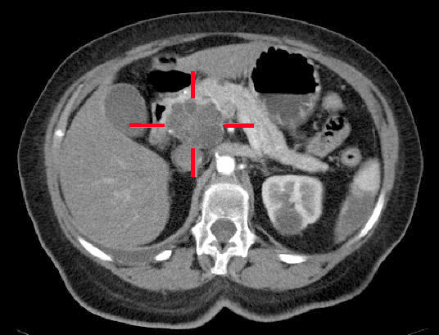
Imaging Findings
Pancreatic Mass
Which strategies helped you solve the case? (2min)
https://step2.medbullets.com/oncology/120443/pancreatic-cancer

Slide 15
Decision Trees, Workup & Revisiting Differentials​
Create a basic assessment and plan

Slide 16
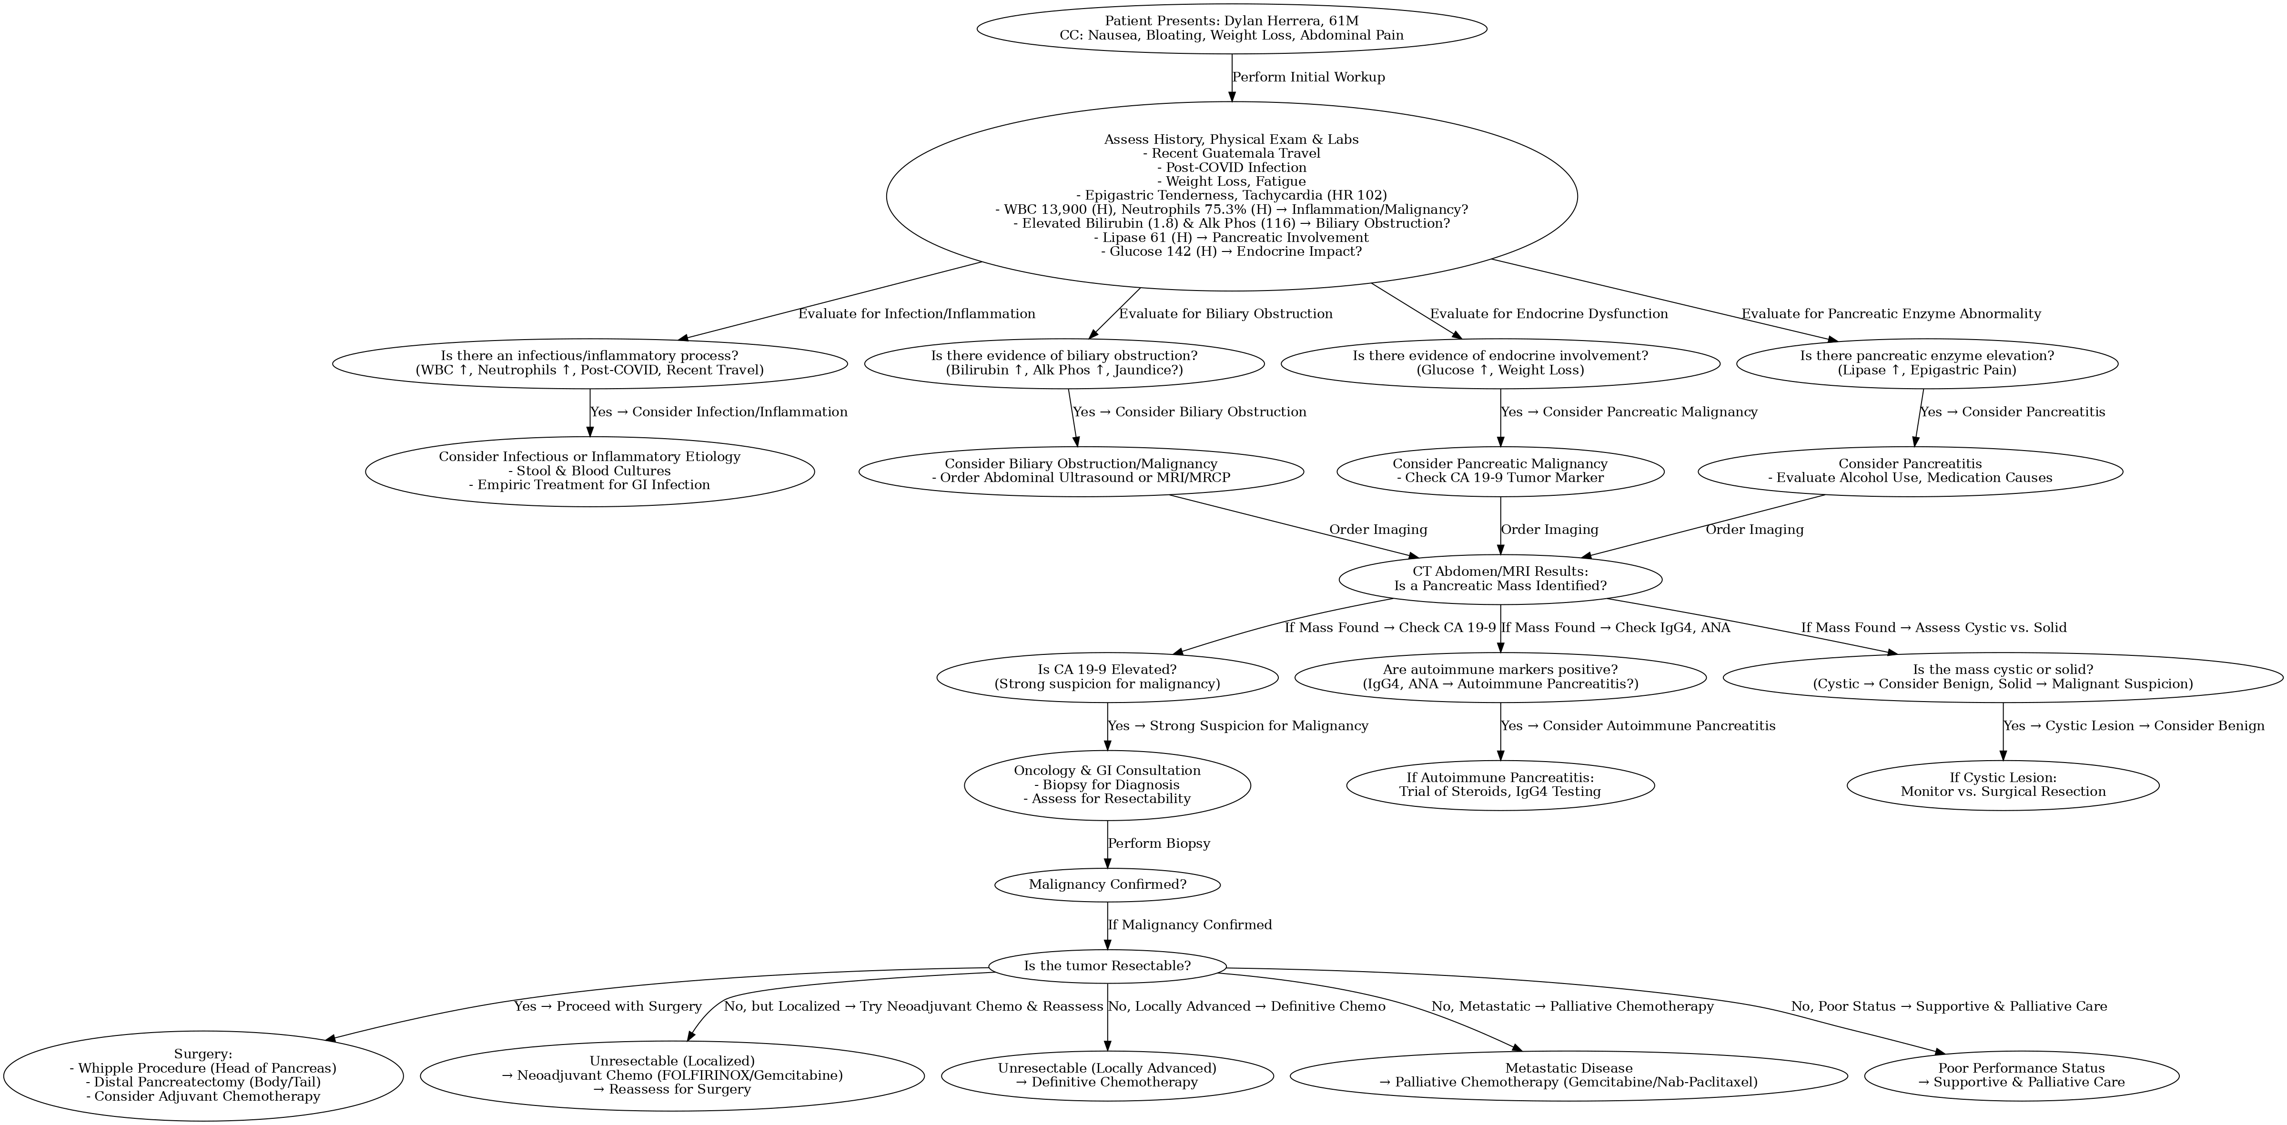
Decision Trees & Workup​

Slide 17
Research & Ethical Considerations
AI for new studies, treatments, or clinical trials that Mr. Herrara may be eligible for
Information Sharing and HIPAA
ChatGPT on a native Carilion Server
https://www.ncbi.nlm.nih.gov/research/trialgpt/

Slide 18
Health Literacy & Patient-Centered Language
3. Come together to discuss how AI can be used to relay complex medical information in patient-friendly language for diagnosis and interventions.
1. Imagine you are a student on service. How would you plan to communicate CT scan findings and the next steps? (2 mins)
2. Use ChatGPT to generate tips that might assist in breaking bad news and follow-up. Compare this with what your group developed. (2 mins)

Slide 19
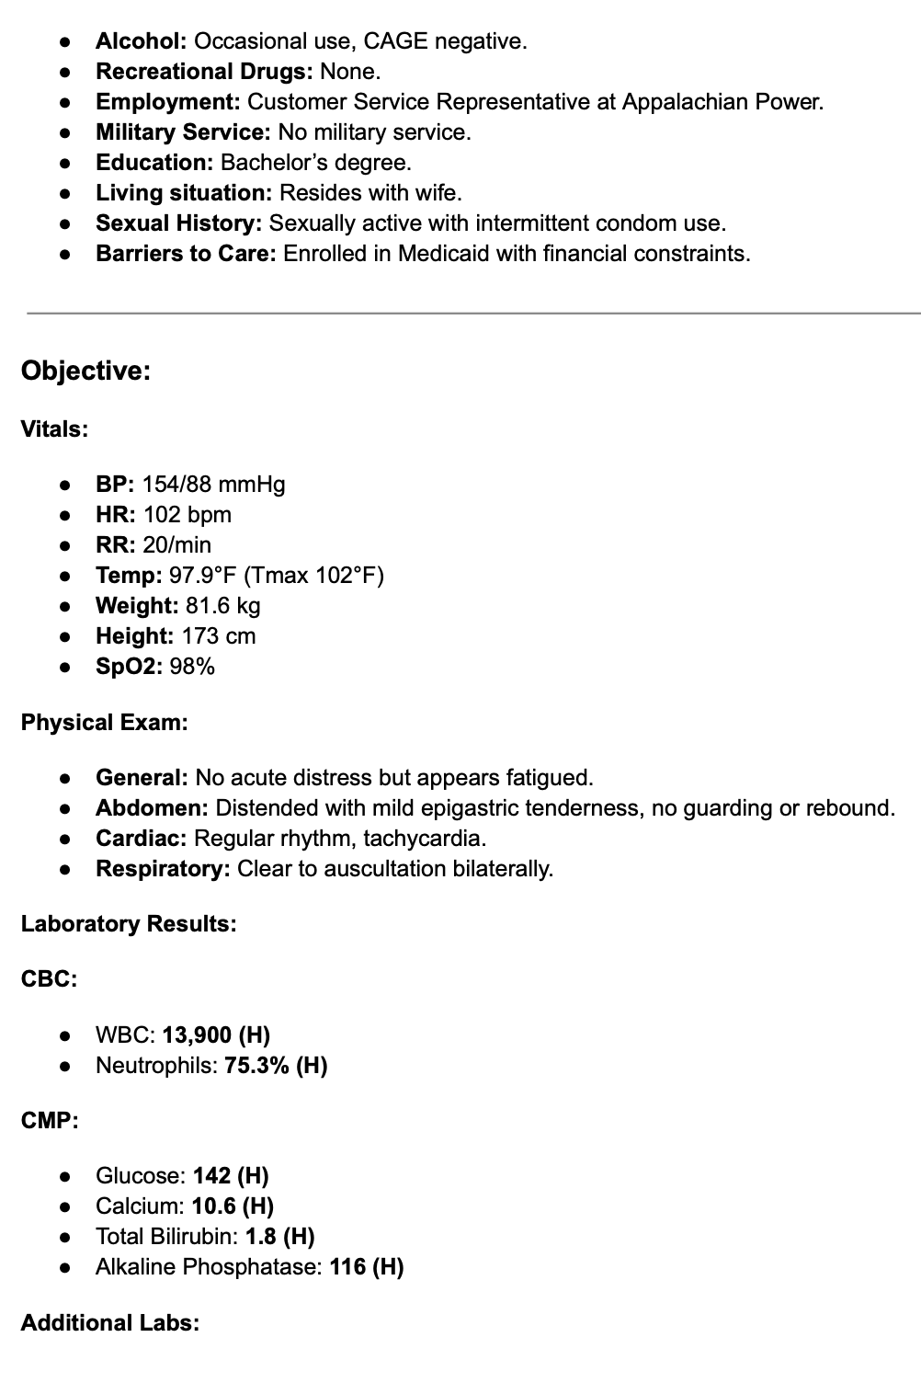
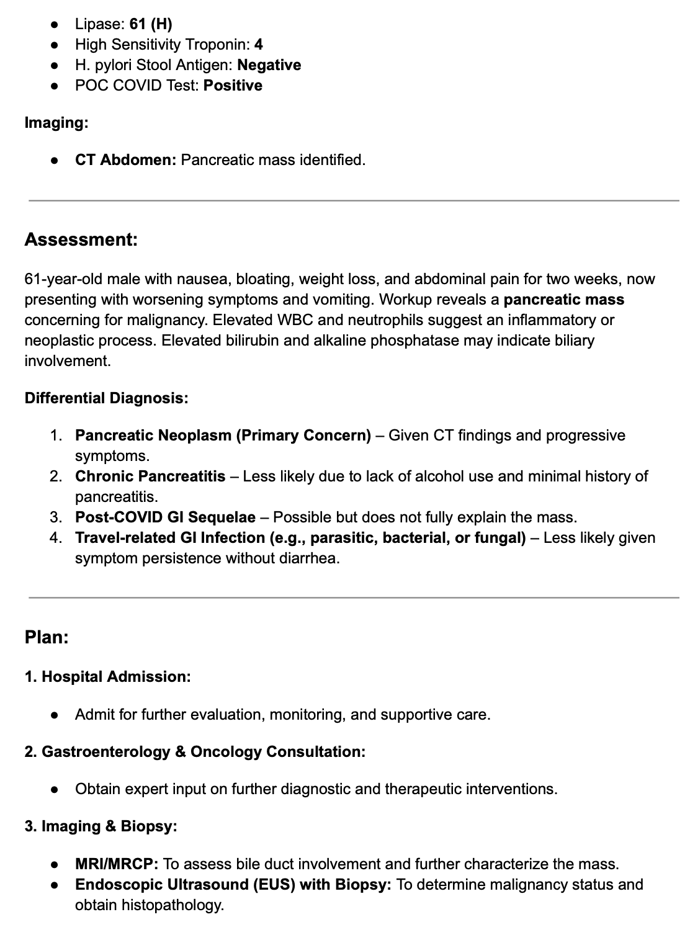
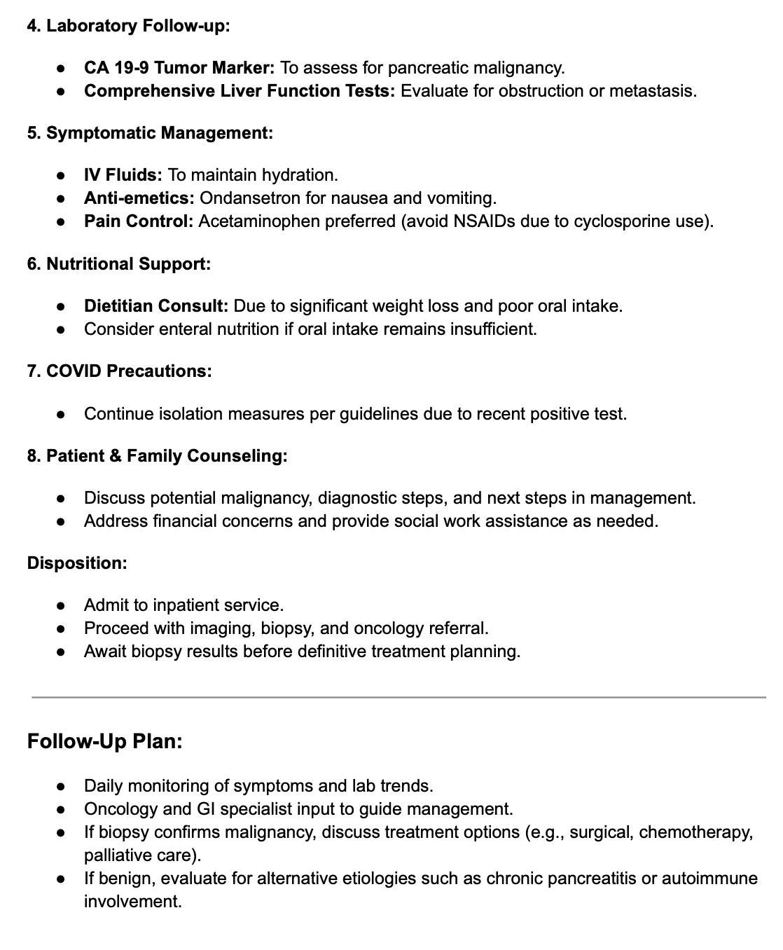
SOAP Note & End-of-Visit Summary

Slide 20
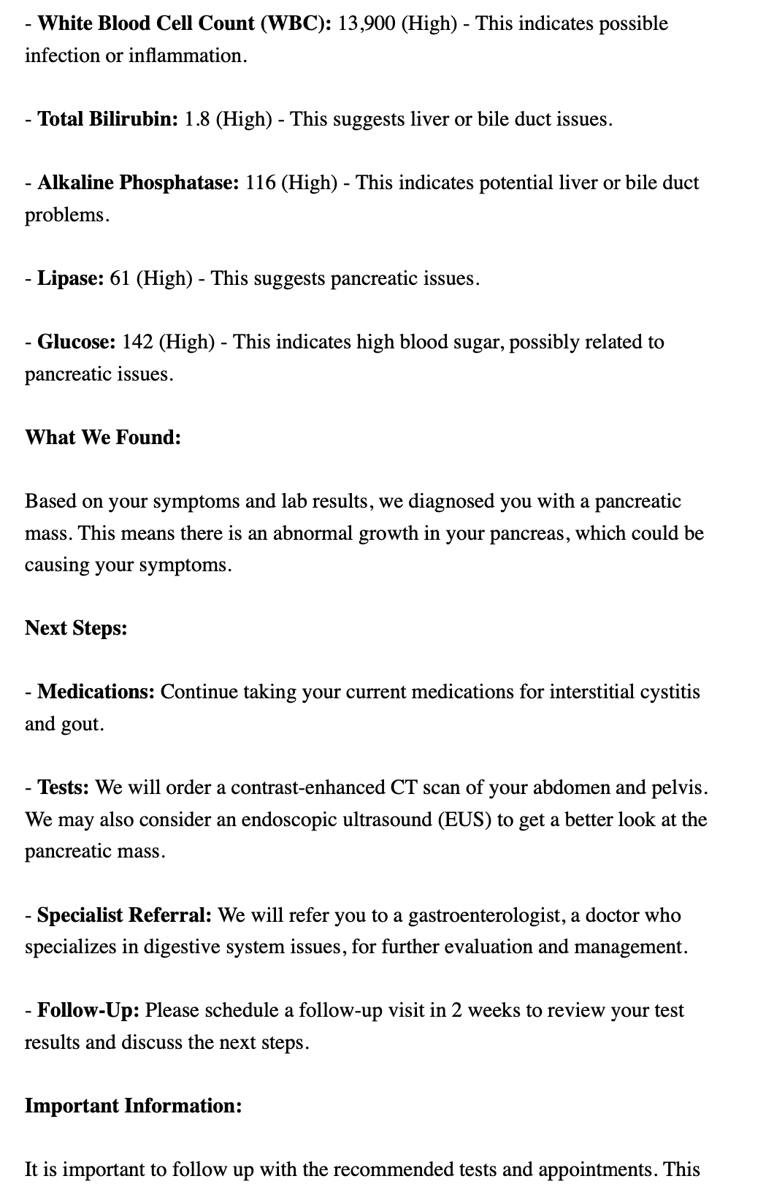
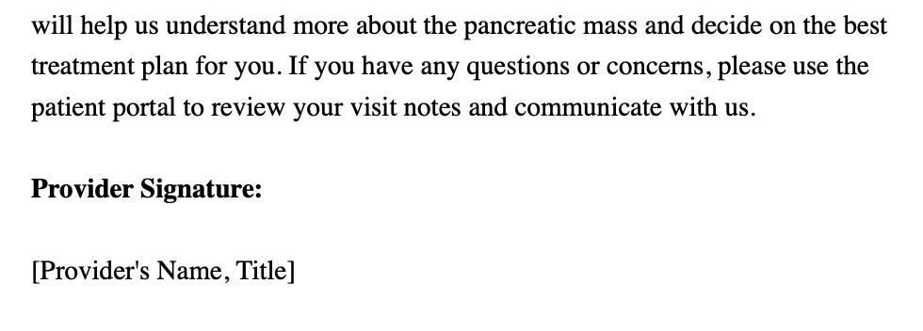
Discharge Summary

Slide 21
SWOT Discussion
Strengths, Weaknesses, Opportunities, and Threats
Favorable
Unfavorable
The SWOT analysis is a strategic planning tool that encouraged group or individual reflection on an assessment of the strengths, weaknesses, opportunities, and threats of a particular strategy and how to best implement it.
BetterEvaluation. SWOT analysis. BetterEvaluation website. https://www.betterevaluation.org/methods-approaches/methods/swot-analysis. Accessed February 14, 2025.
Strengths
What does AI do exceptionally well?
Weaknesses
What are the weaknesses of AI?
Internal
Opportunities
How can AI be used in productively in medical education?
Threats
What are the risks/negative repercussions to using AI in medical education?
External

Slide 22
SWOT Discussion
Favorable
Unfavorable
Let's discuss overall strengths, weaknesses, opportunities, and threats of using AI. (6 min)
Please share your thoughts about the future of AI in enhancing medical education at VTCSOM moving forward. (4 min)
Strengths
What does AI do exceptionally well?
Weaknesses
What are the weaknesses of AI?
Internal
Opportunities
How can AI be used in productively in medical education?
Threats
What are the risks/negative repercussions to using AI in medical education?
External

Slide 23
Thank you!
We welcome your feedback

